Slide 1


Objectives
- define supply and supply schedule
- define & identify supply curve, law of supply
- identify factors influencing supply
- distinguish between movement and shift
- derive market supply from individual supply

Slide 2

In the market sellers supply G &S
SUPPLY :
The quantities of a good that producers are willing and able (has capacity) to sell at different prices in a specified period, ceteris paribus

Slide 3
SUPPLY:
Price and Quantity has a direct relationship meaning when price rises, produces quantity supplied also rise n vice versa
Rising prices acts as an incentive for producers to expand their supply to increase profits!

Slide 4
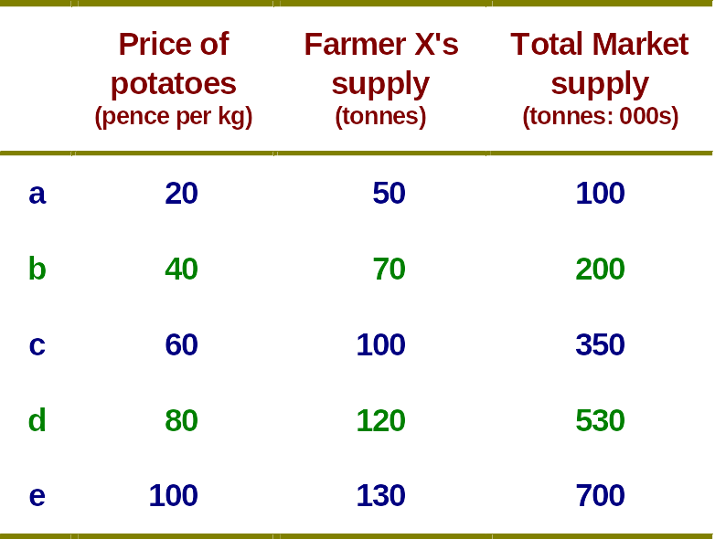
The supply schedule:
The supply of potatoes (monthly)

Slide 5
Supply schedule
A table showing the various quantities of goods an individual producer or a group of producers are willing and able to supply at various prices for a certain time period
Market supply schedule/curve – horizontal summation of the individual supply schedule/curve

Slide 6

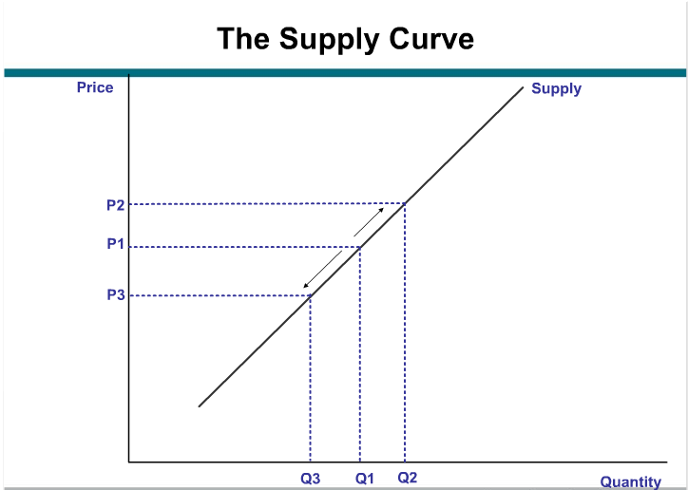
Expansion of supply
Contraction of supply

Slide 7
Supply curve
A graph showing the various quantities producers are willing and able to supply and make available for sale at various price levels for a given time period, cp
Slopes upwards due to the law of supply
  As price rises, quantity supplied rises, vice-versa

Slide 8
Determinants of Supply
Factors influencing supply

Slide 9
Price :
A change in price involves a movement along the supply curve

Slide 10
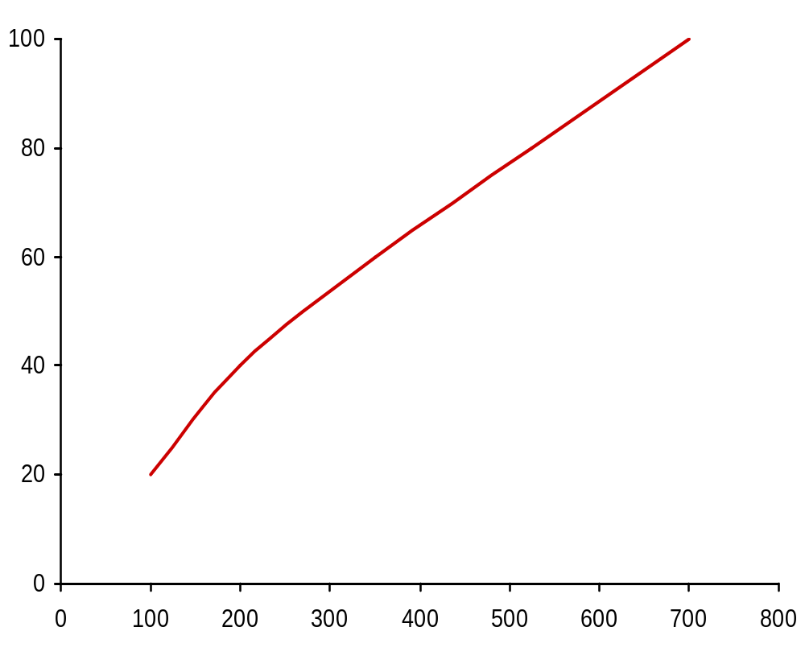

Market supply of potatoes (monthly)
e
Supply
d
P
20
40
60
80
100
Q
100
200
350
530
700
a
b
c
d
e
c
Price (pence per kg)
b
a
Quantity (tonnes: 000s)

Slide 11
Movement vs. shifting
Movement
  Caused by changes in the price, ceteris paribus
  Price rises, quantity supplied rises – expansion of supply
  Price falls, quantity supplied falls – contraction of supply
  Known as a change in quantity supplied
Shifting
  Caused by changes in non-price determinants
  Increase in supply: rightwards shift
  Decrease in supply: leftwards shifts
  Known as a change in supply
Notes:
5

Slide 12
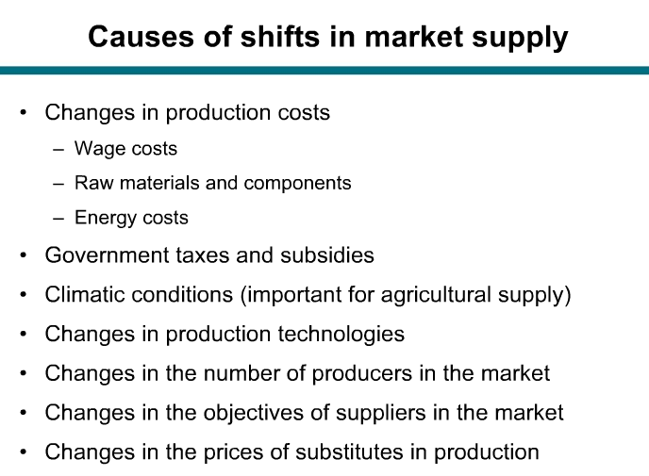

Slide 13
Factors influencing supply : non-price determinants
Production costs – higher cost, supply decreases
Government policy – lower taxes, higher subsidy- supply increases
Climate – good climate, good harvest – supply increases
Technology – rapid, advanced tech – supply increases
No. of producers – more firms/producers – supply increases
Substitutes in supply – higher price of substitutes and/or lower cost, substitutes more profitable – supply of this good decreases
more resources/ high capacity/high capital investment/ high labour productivity – supply increases

Slide 14
Shifts in the supply curve
P
S₀
S₁
Increase
O
Q
fig

Slide 15
Shifts in the supply curve
P
S₂
S₀
S₁
Decrease
Increase
O
Q
fig

Slide 16
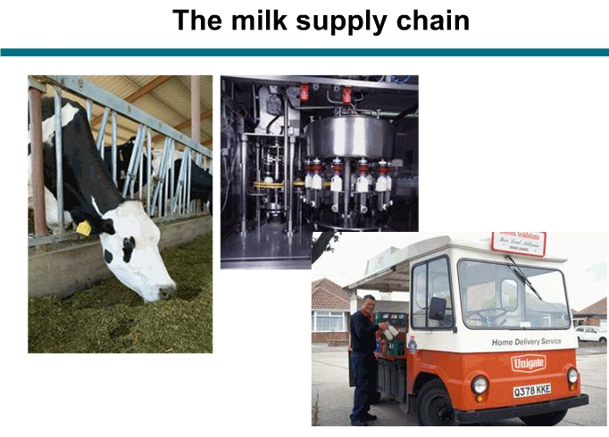


Slide 17
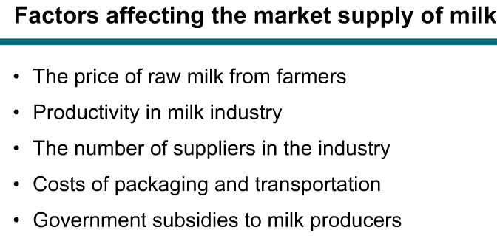

Slide 18
Class activity
Construct a table outlining the factors influencing supply.
Construct a chart to distinguish ‘a change in supply’ and ‘a change in quantity supplied’.

